Slide 1
Negative Impact of Sitting in the Workplace
Shelby Mendez, PT, DPT, FAAOMPT, CSCS
Dr. Steven Parks, MD, MPH

Slide 2
Background
Physical Effects
Adverse Health Effects
Solutions
1
2
3
4

Slide 3
Background
1

Slide 4
Background
Modern society demands increasingly larger amounts of time spent interfacing with computers and tablets and commuting to and from work.
Increased emphasis on computers and social media have resulted in larger spans of time spent sitting.
Notes:
Western culture has moved away from the physically demanding activities of our forbearers
We now spend increasing amounts of time being sedentary

Slide 5
Background
Sitting and Sedentary Epidemiology
In 1940 there were 9,400 people employed in agriculture.
Today there are 2,200.
Manufacturing jobs also on the decline.
Blue collar workers have a daily step count 3.5 times that of white-collar workers.
In the early 1960s almost half the jobs in private industry in the United States required at least moderate intensity physical activity.
Now less than 20% demand this level of energy expenditure.
We burn 100 less calories a day today.
“Americans spend the majority of their time in behaviors that expend very little energy.”
Mathews et al.

Slide 6
Physical Effects
2

Slide 7
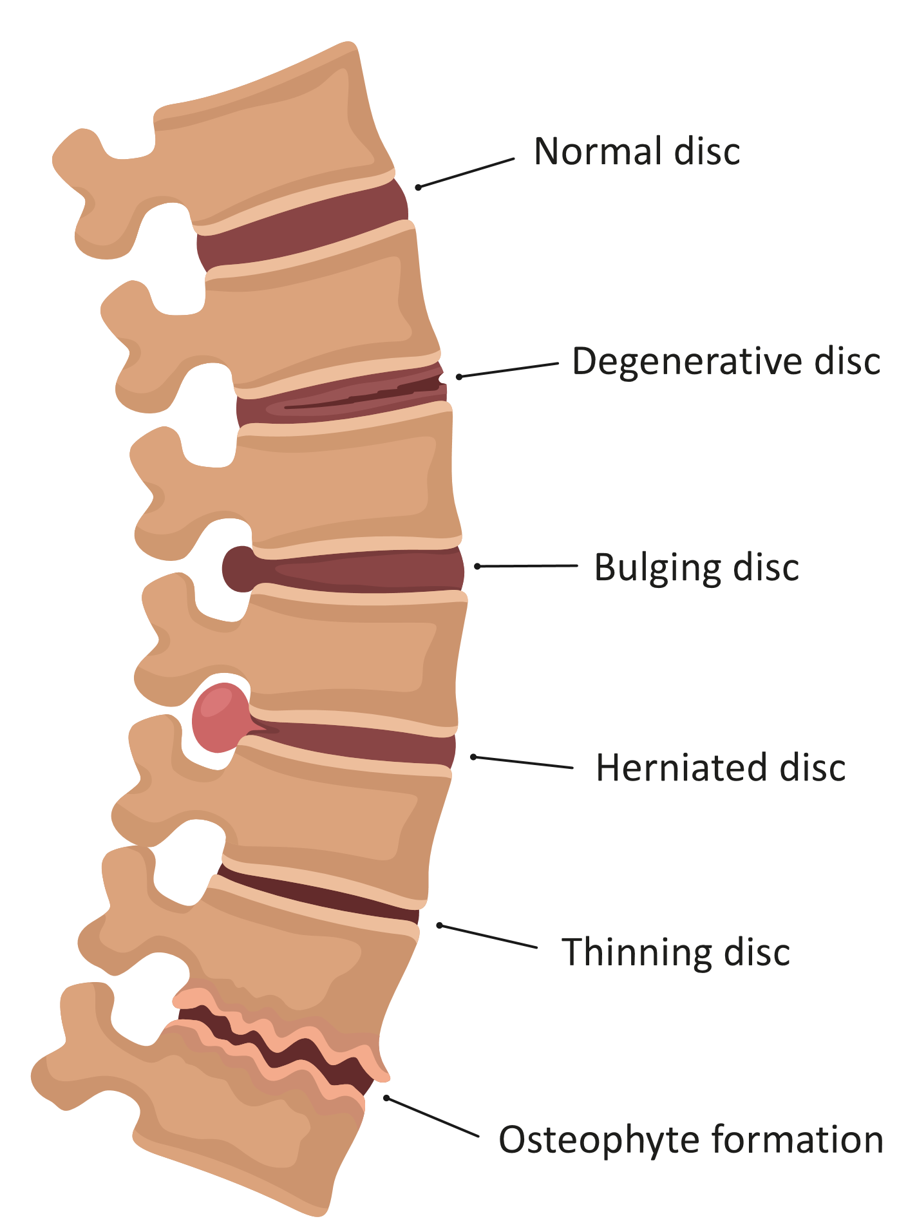
Physical Effects
Disc Pressure
Sustained periods of trunk “slouching” compress the discs and create a force gradient posteriorly.
Theorized to encourage the nucleus to migrate towards the nerves and spinal cord of the low back.

Slide 8
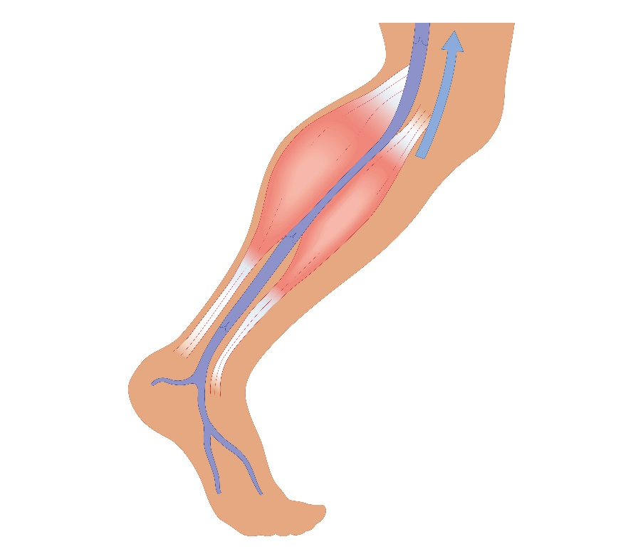
Physical Effects
Circulatory
When we sit, we do not create muscle contractions in our legs.
This pumping effect decreases circulation.
These muscles remain dormant, reducing the overall calories burned by the body; metabolism and cardiovascular demand slows.
Reduced blood flow in the lower extremities has been correlated to increases risk for deep vein thrombosis (DVTs).
People who remain seated for excessive durations have the most significant risk.

Slide 9
Physical Effects
Myofascial
Sitting encourages protraction of the shoulder which affects the neck and rotator cuff.
Sitting compresses the knee-cap into the thigh bone.
Possible disruption of the deep pelvic MM.
Length-tension adaptations, Psoas, quads, lower trapezius.

Slide 10
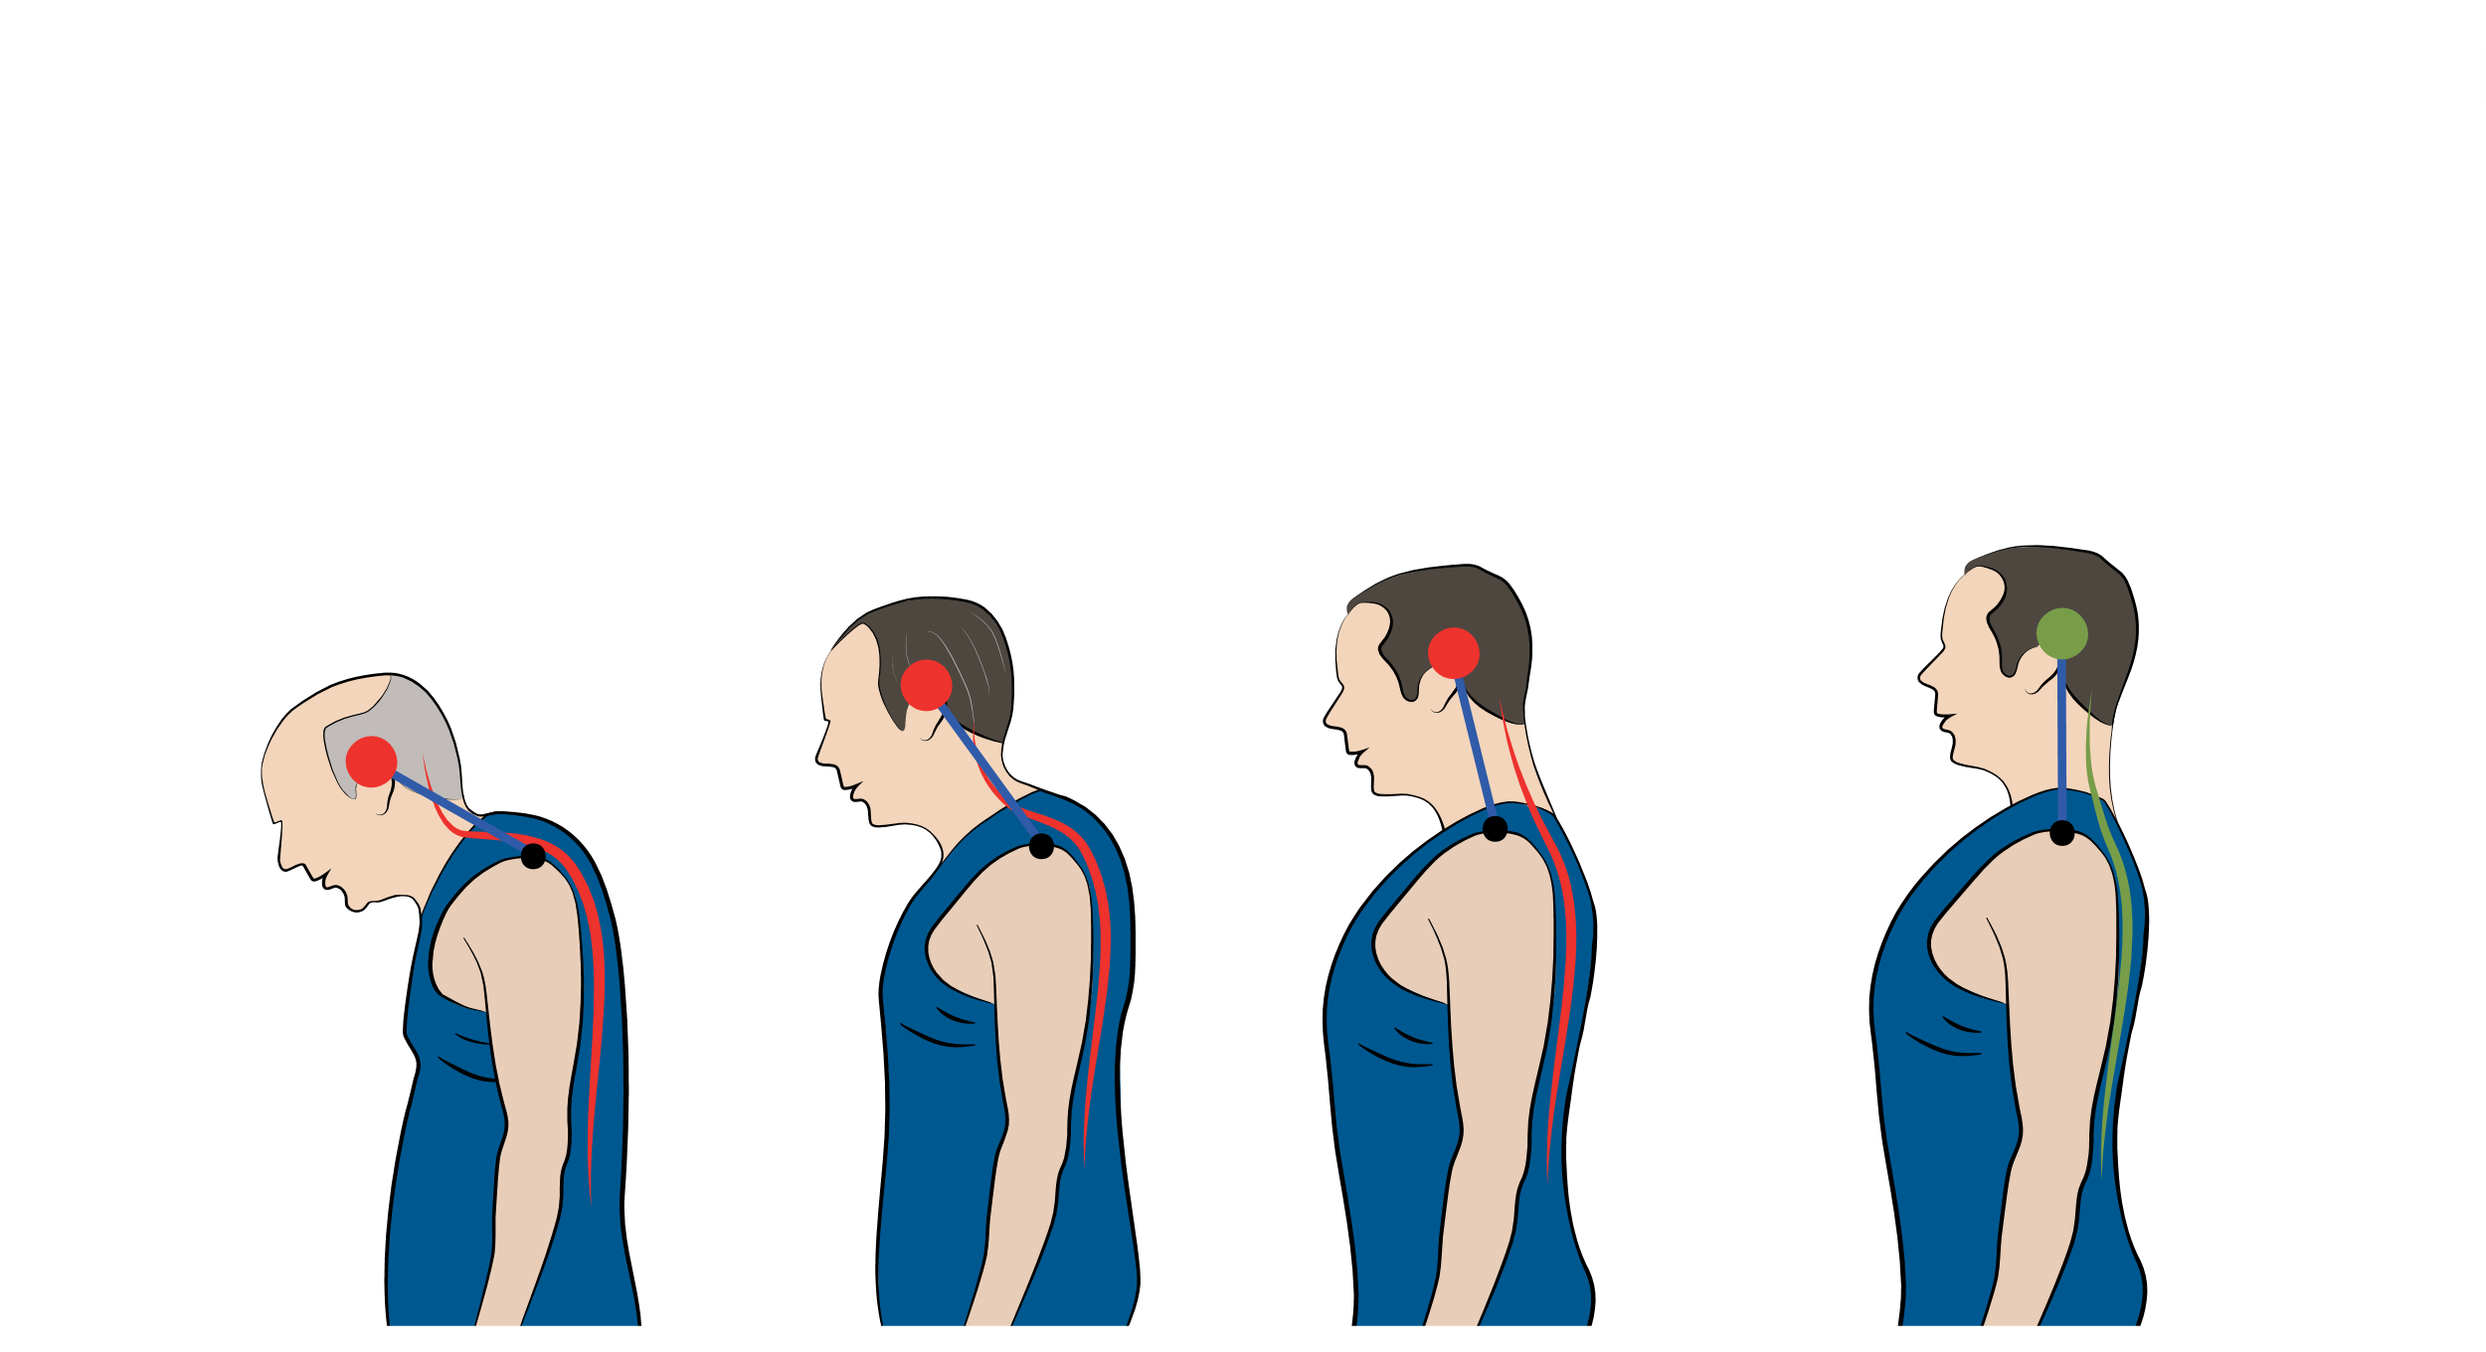
Physical Effects
Myofascial
“For every inch of Forward Head Posture, it can increase the weight of the head on the spine by an additional 10 pounds.”
Kapandji, Physiology of Joints, Vol. 3

Slide 11
Adverse Health Impacts
3

Slide 12
Adverse Health Impacts
Caloric Consumption
Sitting utilizes approximately half the calories as standing
“Non-exercise thermogenesis”
Standing calorie calculator: http://www.juststand.org/OnlineToolbox/tabid/637/language/en-US/Default.aspx

Slide 13
Adverse Health Impacts
LPL
Prolonged sitting has been shown to reduce the production of lipoprotein lipase (LPL)
LPL contributes to the soft tissue-level regulation of lipoproteins and glucose
LPL is an enzyme that is present in adipose and muscle tissue which is involved in the regulation of triglycerides and cholesterol. When LPL production increases, high-density lipoprotein (HDL) levels increase and a resistance to “diet-induced high triglycerides as well as high cholesterol” occurs.

Slide 14
Solutions
4

Slide 15
Solutions
Concentra ADApt program
Office Ergonomic Evaluation: Assessment by Concentra® physical therapist for employee workstation
Office Ergonomics Presentation: Group presentation by Concentra physical therapist
Just Stand
www.juststand.org

Slide 16
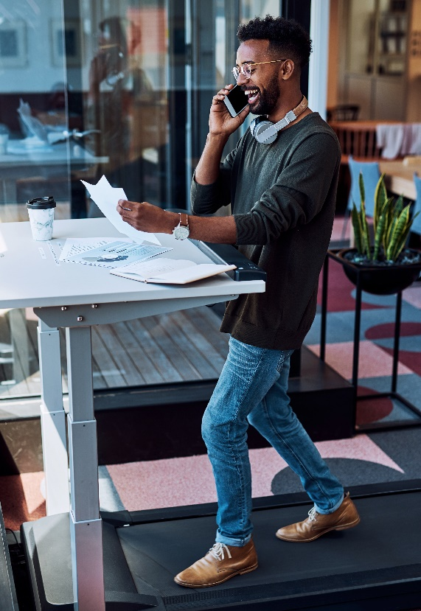
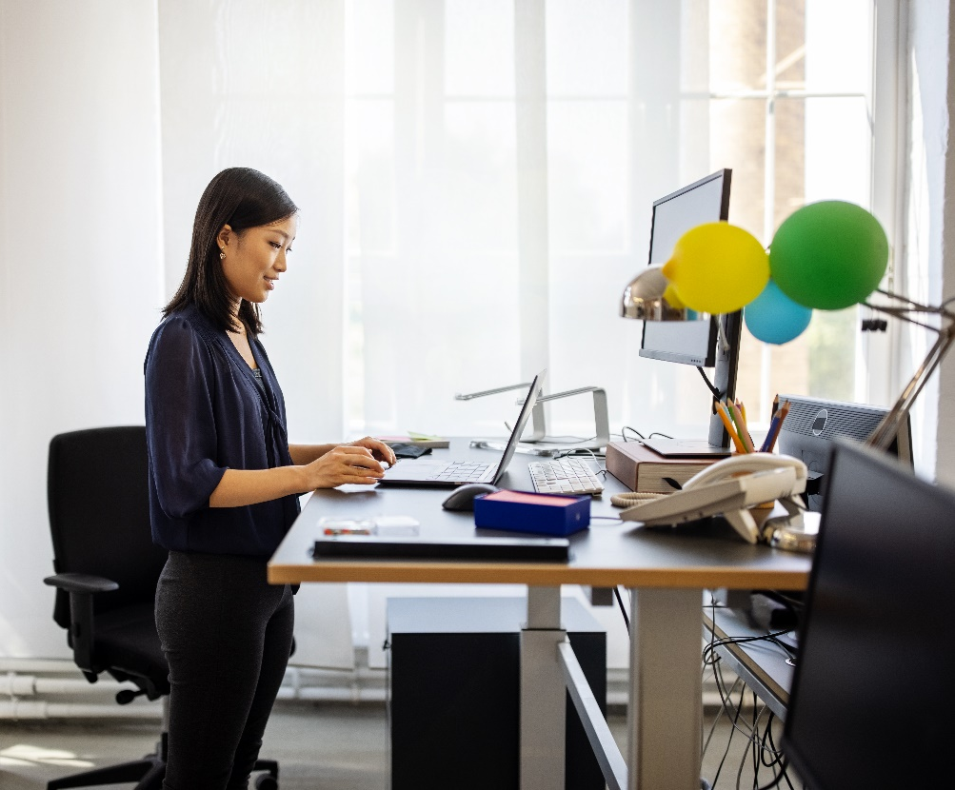
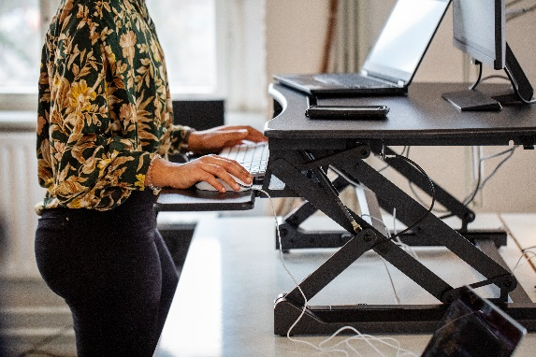
Solutions

Slide 17
Concentra Florida Leadership
Contact Information
Q&A
East Florida (Jacksonville, Palm Beach County, Broward County, Miami Dade County)
Medical: Dr. Steven Parks – SRParks@Concentra.com
Therapy: Shelby Mendez – SMendez@Concentra.com
Operations: Adriana Alvarado – Adriana_Alvarado@Concentra.com
Sales: Amber Nusbaum – Amber_Nusbaum@Concentra.com
West/Central Florida (Tampa, Orlando, Ocala, Sarasota/Bradenton)
Medical: Dr. Cori Repp – CRepp@Concentra.com
Therapy: Mike Naser – Michael_Naser@Concentra.com
Operations: Debbie Payne – DKPayne@Concentra.com
Sales: Amber Nusbaum – Amber_Nusbaum@Concentra.com

Slide 18
Resources
Bureau of Labor Statistics Employment status of the civilian non-institutional population, 1940 to date. ftp://ftp.bls.gov/pub/special.requests/lf/aa2010/pdf/cpsaat1.pdf.
Brownson RC, Boehmer TK, Luke DA. Declining rates of physical activity in the United States: what are the contributors? Annu Rev Public Health. 2005;26:421-43.
Estimating Historical Changes in Physical Activity Levels. Med J Aus. 2001; 175(11-12), 635-636.
Basset Jr. DR, Schneider PL, Huntington GE. Physical Activity in an Old Order Amish Community. Med Sci Sports Exerc. 2003; 79-85.
Bureau of Labor Statistics Employment status of the civilian non-institutional population, 1940 to date. ftp://ftp.bls.gov/pub/special.requests/lf/aa2010/pdf/cpsaat1.pdf. Accessed 10-24-2012.
Church TS, Thomas DM, Tudor-Locke C, et al. Trends over 5 Decades in U.S. Occupation-Related Physical Activity and Their Associations with Obesity. PLoS. 2011;5(6): e19657. http://www.ncbi.nlm.nih.gov/pmc/articles/PMC3102055/pdf/pone.0019657.pdf. Accessed 10-26-2012.
Steele, R, & Mummery, K (2003). Occupational physical activity across occupational categories. Journal of Science and Medicine in Sport 6 (4): 398-407.
Mathews CE, Kong CY, Freedson PS. Amount of Time Spent in Sedentary Behaviors in the United States, 2003–2004. Am J Epidemiol. 2008;167(7):875–881.
Anderson BJ, Ortengren R, Nachemson Al, et al. The sitting posture: an electromyographic and discometric study. Orthop Clin North Am. 1975; 6(1):105-20.

Slide 19
Resources
Nachemson A. Towards a better understanding of low-back pain: a review of the mechanics of the lumbar disc. Rheumatol. 1975;14(3):129-143
O’Sullivan PB, Grahamslaw KM, Kendall MM, et al. The effect of different standing and sitting postures on trunk muscle activity in a pain-free population. Spine. 2002; 27(11): 1238-1244.
Callaghan JP, McGill SM. Low back joint loading and kinematics during standing and unsupported sitting. Ergonomics. 2001;44(3): 280-294.
Beasley R, Heuser P, Raymond N. SIT (seated immobility thromboembolism) syndrome: a 21rst century lifestyle hazard. New Z Med J. 2005; 118.
West J, Perrin K, Aldington S, et al. A case-control study of seated immobility at work as a risk factor for venous thromboembolism. JRSM Short Rep. 2008; 101:237-243.
Healy B, Levin E, Perrin K, Prolonged work and computer-related seated immobility and risk of venous thromboembolism. JRSM Short Rep. 2010;103: 447-54.
Suadican P, Hannerz H, Bach E, et al. Jobs encompassing prolonged sitting in cramped positions and risk of thromboembolism: cohort study. JRSM Short Rep. 2012;3(8).
Aldington S, Pritchard A, Perrin K. Prolonged seated immobility at work is a common risk factor for venous thromboembolism leading to hospital admission. Int Med J. 2008; 38(2): 133-135.
Hitos K, Cannon M, Garth S, et al. Effect of exercises on popliteal venous flow during prolonged immobility of seated subjects: implications for prevention of travel-related deep vein thrombosis. Int J Thromb Heam. 2005; 5:1890-1895.

Slide 20
Resources
O’Sullivan PB, Grahamslaw KM, Kendall MM, et al. The effect of different standing and sitting postures on trunk muscle activity in a pain-free population. Spine. 2002; 27(11): 1238-1244.
Callaghan JP, McGill SM. Low back joint loading and kinematics during standing and unsupported sitting. Ergonomics. 2001;44(3): 280-294.
Shuldt K, Ekholm J, Harms-Ringdahl K, et al. Effects of changes in sitting work posture on static neck and shoulder muscle activity. Ergonomics. 1986; 29(12): 1525-1537.
Chiu TT, Ku WY, Lee MH, et al. A Study of the Prevalence of and Risk Factors for Neck Pain Among University Academic Staff in Hong Kong. J Occup Rehabil. 2002; 12(2): 77-91.
Chu TW, Lamb TWL. The prevalence of and risk factors for neck pain and upper limb pain among secondary school teachers in Hong Kong. J Occup Rehabil. 2007; 19(1): 19-32
The Compendium of Physical Activities. 2011 Compendium of Physical Activities Reference List Category 7 – Inactivity Quiet. https://sites.google.com/site/compendiumofphysicalactivities/Accessed 10-27-2012.
Levine JA, Schleusner SJ, Jensen MD. Energy Expenditure of Non-Exercise Activity. Am J Clin Nutr. 2000;72:1451-4.
Hamilton MT, Etienne JM, McClure WC, et al. Role of local contractile activity and muscle ﬁber type on LPL regulation during exercise. Am J Physiol Endocrinol Metab. 1998; 275:674 -E1016-E1022.
Bey L, Hamilton MT. Suppression of skeletal muscle lipoprotein lipase activity during physical inactivity: a molecular reason to maintain daily low-intensity activity. J. Physiology. 2003;551.2: 673-682.
Shimada M, Shimano H, Gotoda T. Overexpression of Human Lipoprotein Lipase in Transgenic Mice: Resistance to Diet-Induced Hypertriglyceridemia and hypercholesterolemia. J Biol Chem. 1993. 268(24): 17924 – 17929.

